Slide 1

Enhancing Multi Class Anomaly Detection through Diffusion Refinement
Paper review
Gibeom Kim (UST)

Slide 2

Index
Paper abstract
1-1. Anomaly Detection
1-2. Mahalanobis Distance
Model
Conclusion
Notes:
I don't know how much you know about Padim, so I’ll explain a quick overview of the basics of Padim

Slide 3
1. Paper abstract
Anomaly detection을 위한 방법은 크게 3가지로 나눌수 있다
Padim, patchcore 같은 pretrained cnn 모델 이용
Image reconstruction을 이용
Dnn 학습을 이용
이 중 1번과 2번을 같이 사용하는 모델
단일 클래스 예측이 아닌 멀티 클래스 예측 모델

Slide 4
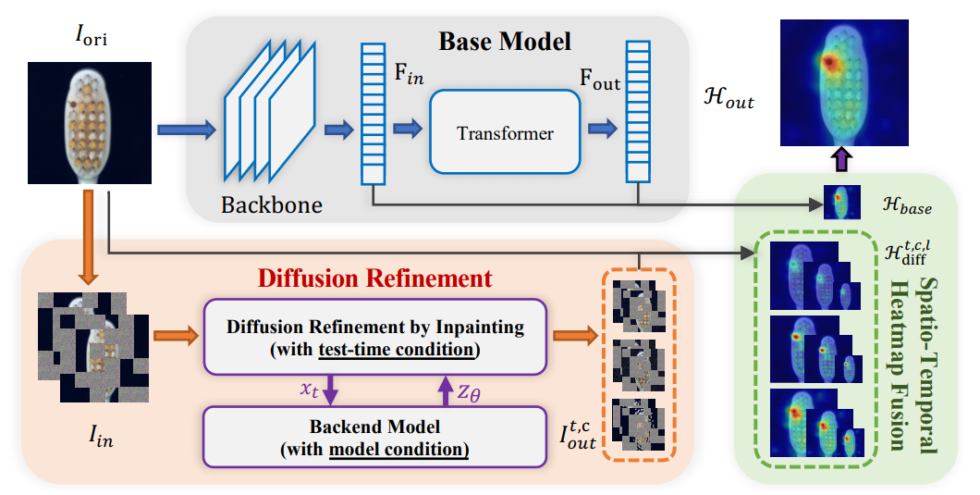
1. Paper Abstract
Simplified data processing flow of a PaDim model

Slide 5
2. Model
Base model
For dimensionality reduction, part of channels are used to calculate mean and covariance

Slide 6
2. Model
Base model
For dimensionality reduction, part of channels are used to calculate mean and covariance

Slide 7
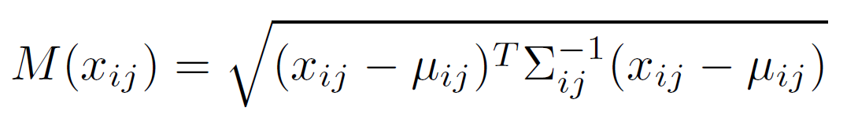
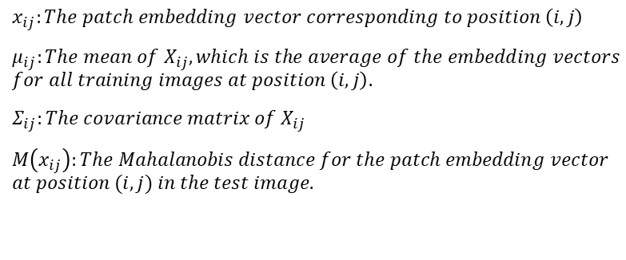
2. Model
Inference : computation of the anomaly map
Test images are input into the pre-trained CNN model in the same method as the previous process.
The Mahalanobis distance is then calculated to compare how far each patch is from the mean and covariance values of the normal images on a patch-by-patch.
$$x_{ij}:The patch embedding vector corresponding to position \left(i, j\right)$$
$μ_{ij}:The mean of X_{ij}, which is the average of the embedding vectors$ $for all training images at position \left(i, j\right).$
$Σ_{ij}:The covariance matrix of$ $X_{ij}$
$M\left(x_{ij}\right):The Mahalanobis distance for the patch embedding vector$
$$at position (i, j) in the test image.$$

Slide 8
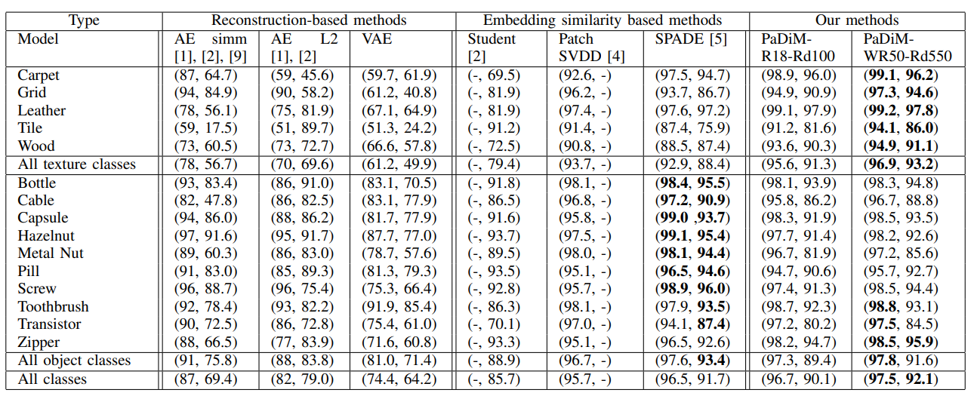
3. Conclusion
Combining the outputs of the first three layers of pre-trained CNN model and considering the correlations between them.
No need to train deep learning model, and inference taking approximately 150 seconds per class when using cpu.
Achieved State-Of-The-Art (SOTA) in 2020

Slide 9
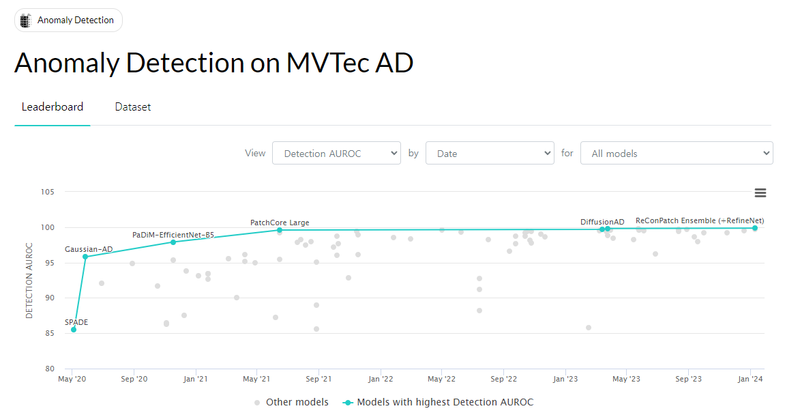
3. Conclusion

Slide 10
Thank you

